Slide 1
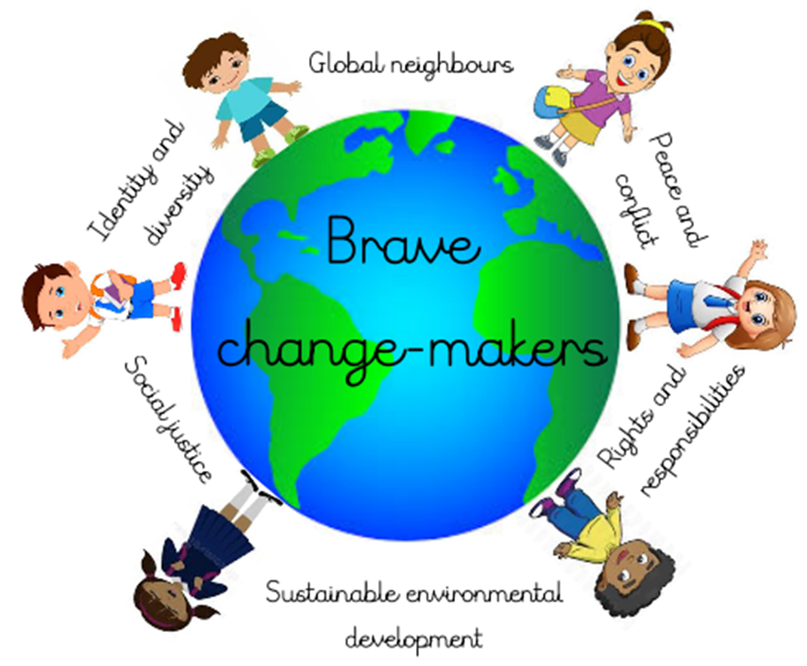

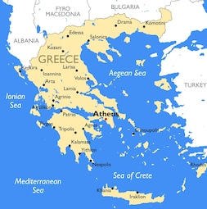
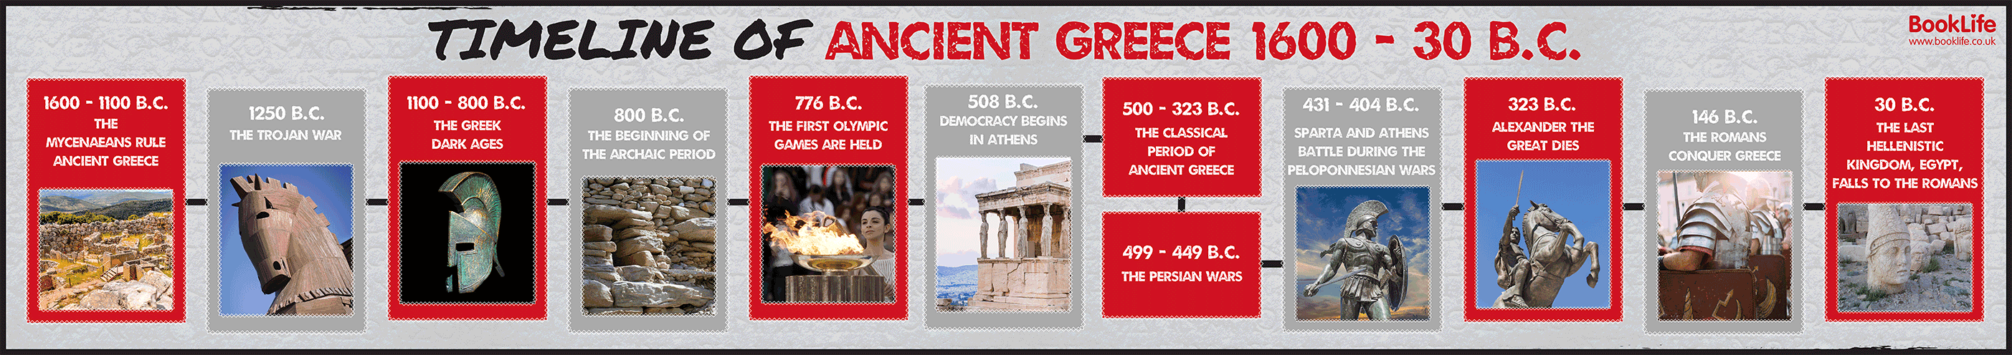
Spring Term 2025 Year 5 and 6
Connected Curriculum Theme: Rights and Responsibilities
Attitudes: Respect for people and human rights
Topic: Ancient Greece
Our Big Question: How can we make our voices heard?
Brave Changemakers Outcome: Interviewing our local MP
Learning questions:
Who were the Ancient Greeks and where and when did they live?
What was the role of pottery in Ancient Greek civilization?
What was the legacy of the Ancient Greek civilization?
How did the Ancient Greeks develop democracy?
Did everyone have their voice heard in Ancient Greece?
How do people make their voice heard today? How does this compare to Ancient Greece?
How does the geography of Greece today compare to that of Ancient Greece?
How can I make my voice heard?
Some Facts (Knowledge & Understanding) | Brave Changemaker Skills
About 2,500 years ago Greece was one of the most important places in the ancient world. The Ancient Greeks were great thinkers, warriors, writers, actors, athletes, artists, architects and politicians. Greece is a country in the continent of Europe and borders Albania, North Macedonia, Bulgaria and Turkey. The capital city is Athens. The ancient Olympic games are dated back to 776 BC. The Ancient Greeks worshipped several gods, including Zeus, Poseidon and Hera The Ancient Greeks developed different forms of government. Athens and Sparta were the two most famous and powerful city states in Ancient Greece. Their forms of government were very different. | Making Decisions – Identify and plan appropriate action(s) and opportunities to make own voice heard. Challenge viewpoints which perpetuate inequality and injustice. Reflect on learning from taking action.
Key Vocabulary
Culture The ideas, customs, and social behaviour of a particular people or society | Myth A traditional story, often explaining a natural phenomenon, sometimes involving supernatural beings Also means a widely held but false belief or idea
Legacy Something left or handed down by a predecessor | Democracy Control of an organisation or group by the majority of its members
Citizen A legally recognised inhabitant of a particular town or city | Responsibility Being accountable or to blame for something
Ancient Belonging to the very distant past and no longer in existence | Power The ability or capacity to direct or influence the behaviour of others
Discrimination The unjust or prejudicial treatment of different categories of people | European Relating to the continent of Europe or its inhabitants

Slide 2
Subject | Term 3 and 4 Learning
English | Reading and writing Greek myths inspired by Theseus and the Minotaur Writing non-chronological reports about mythical monsters Reading about Greek Gods and Alexander the Great Writing discussion texts to compare both sides of an argument
Maths | Measurement and converting units Perimeter and area of shapes Volume of shapes Statistics
Science | Forces
R.E. (Religious Education) | What does it mean to be a Muslim in Britain today?
Computing | Media &
PE (Physical Education) | Badminton
History | Ancient Greeks – their culture and legacy, particularly focused on democracy and making their voices heard
Geography | Greece – location, geographical features, comparison between ancient Greece and modern day Greece
Art / Design and Technology | Art – using clay to make Greek jugs Design and Technology – making mechanisms
PSHE (Personal, Social, Health and Economic Education) | Zones of regulations
Music | Film music & Year 6: Dynamics, pitch and texture (Theme: Coast - Fingal’s Cave by Mendelssohn)
French | Presenting myself The family

